Slide 1
COST OF LIVING DATA VISUALIZATION
BY- Hemanth Basapuram Gandla
BATCH- MIP-DA-08

Slide 2


Slide 3
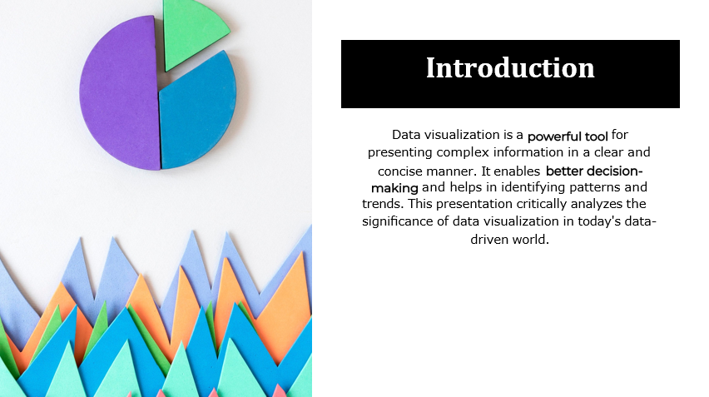

Slide 4


Slide 5
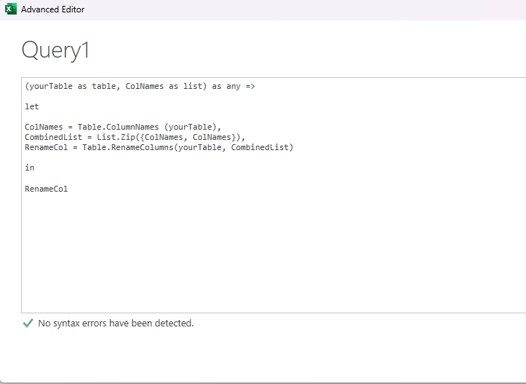
Data preprocessing and cleaning
Conversion of Nan to zero for data analysis was done by find and replace feature on MS Excel.

Slide 6
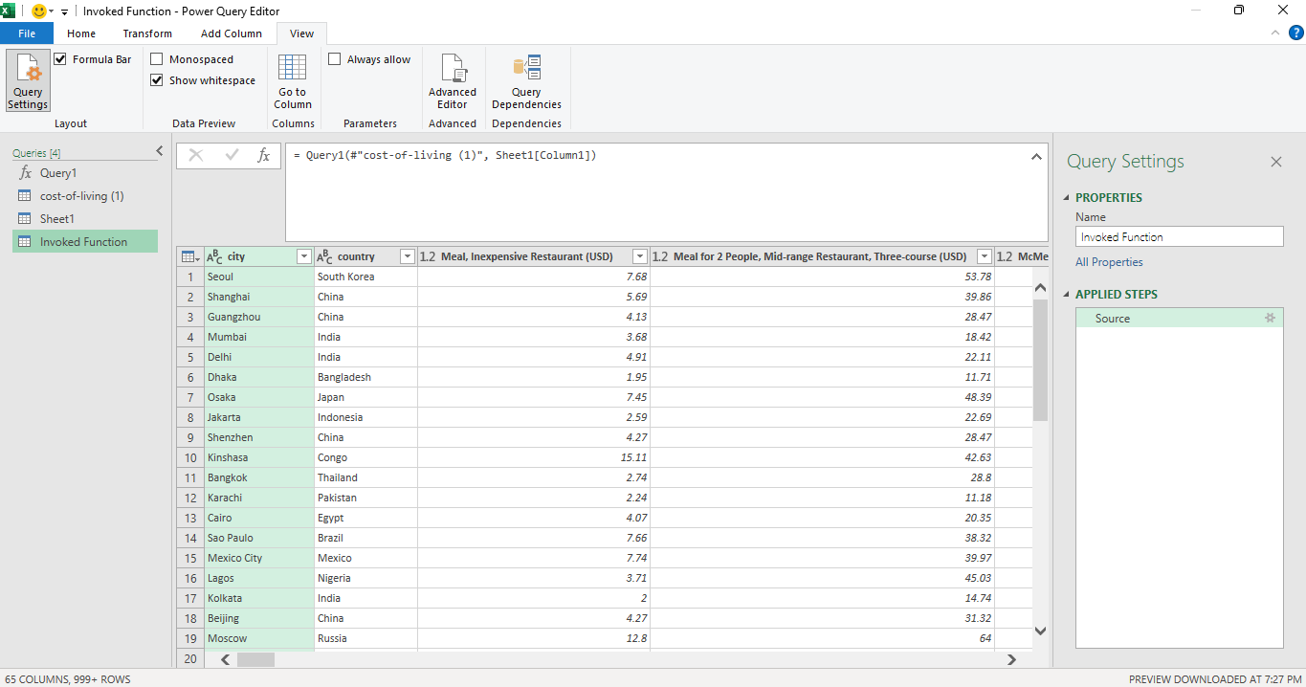

Slide 7
Assumptions made for accurate data visualization
Consumables column Meal, Inexpensive Restaurant (USD) to Cigarettes 20 Pack (Marlboro) (USD)
Transport column One-way Ticket (Local Transport) (USD) to Toyota Corolla Sedan 1.6l 97kW Comfort (Or Equivalent New Car) (USD)
Miscellaneous column Basic (Electricity, Heating, Cooling, Water, Garbage) for 85m2 Apartment (USD) to Cinema, International Release, 1 Seat (USD)
Education column Preschool (or Kindergarten), Full Day, Private, Monthly for 1 Child (USD) to International Primary School, Yearly for 1 Child (USD)
Clothing column 1 Pair of Jeans (Levis 501 Or Similar) (USD) to 1 Pair of Men Leather Business Shoes (USD)
Housing from Apartment (1 bedroom) in City Centre (USD) to Price per Square Meter to Buy Apartment Outside of Centre (USD)

Slide 8
Cities and Countries with the highest and lowest costs of living
Highest cost of living city – Honaira with 641,595.13 USD
Highest cost of living country – Solomon Islands 641,595.13 USD
Lowest cost of living country- Comoros 69.38 USD

Slide 9
Lowest cost of living – Ataq , Alatou Armavir, Al Turrah, Benguela, Bertinoro, Bluefields, Cabinda, Castrolibero, Chimoio, Cidade de Nacala, Citta di Castello, Collie, Dien Bien Phu, Fidenza, Formosa,Huaibei, Iglesias, Inhambane, Ivdel, Karoi, Kasama, Lelydorp, Lipari, Livingstone, Mtwara, Murzuq, Ndalatando, Pyu, Pucalipa, Prokuplje, Poza Rica de Higaldo, Savannakhet , serris, sisimuit, Tobruk, toliara, Victoria falls, voerendaal, waihi with 0 USD

Slide 10
Major cost components contributing to the overall cost of living in a region worldwide
Transportation 76.2%
Education 12.43%
Housing 10.05%
Miscellaneous 0.61%
Consumables 0.26%
Clothing <0.1%

Slide 11
Average salary, Housing costs, and Transportation expenses correlate with cost of living?
An average salary of 1.29K USD in earned worldwide
Housing costs accounts for 9.7% of the total cost
Transportation accounts for 73.51 of the total cost
Via funnel graph

Slide 12
Trends and Patterns
For a any new business of Transportation , clothing or Consumables United States of America is best to establish for high sales

Slide 13
Power BI Desktop
United States
192,493.90
Sum of Consumables
Honiara Niamey Singapore
Tabriz Mahabad Trinidad Orumiyeh Monaco Hamilton London
Burlington Kermanshah
country Average of Total cost

Solomon Islands 641,595.13
Niger 353,293.45 Singapore 287,566.66
Monaco 254,263.41 Hong Kong 152,896.79
Bermuda 140,841.10 Aruba 121,700.64
Cuba 112,617.09
Jersey 108,903.26
Bahamas 107,958.15 Mali 106,555.78
Gibraltar 105,924.84
Total 51,465.68
1.29K
Average of Average Monthly Net …
United States
38,953,301.62
Sum of Transportation
city
51.47K
Average of Total cost
United States
250,785.34
Sum of Clothing
0.0M
0.5M
Sum of Total cost
Money Spent
100%
Sum of …
Sum of …
Sum of …
Sum of …
24.73M (10.05%)
1.49M (0.61%)
0.64M (0.26%)
30.6M (12.43%)
255.06M
40M
Sum of Total c…
Sum of Education, Sum of Tran…
Sum of Transp…
187.49M (73.51%)
30M
Sum of Consumables
Sum of Education Sum of Transportation Sum of Miscellaneous Sum of Clothing
Sum of Housing
Sum of Educa…
30.60M (12%)
20M
Sum of Housi…
24.73M (9.7%)
10M
Sum of Miscel…
1.49M (0.59%)
Sum of Clothi…
1.11M (0.43%)
0M
United States
United Kingd…
China Canada Germany
Italy Switzerland
Japan Brazil Spain France
South Korea
187.49M (76.2%)
Sum of Consu…
0.64M (0.25%)
0.3%
country

